Slide 1
IDEMPOTENT GENERATIVE NETWORK
Gwangwoo Kim
Dec. 1, 2023

Slide 2
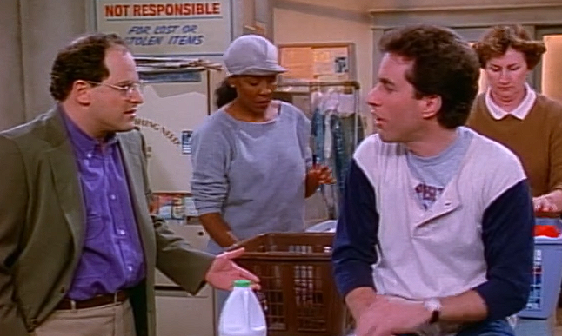
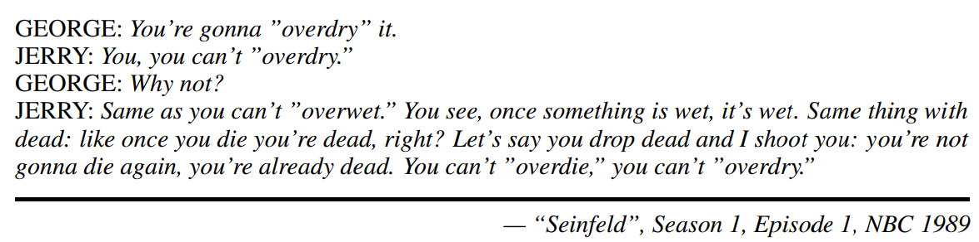
Motivation

Slide 3
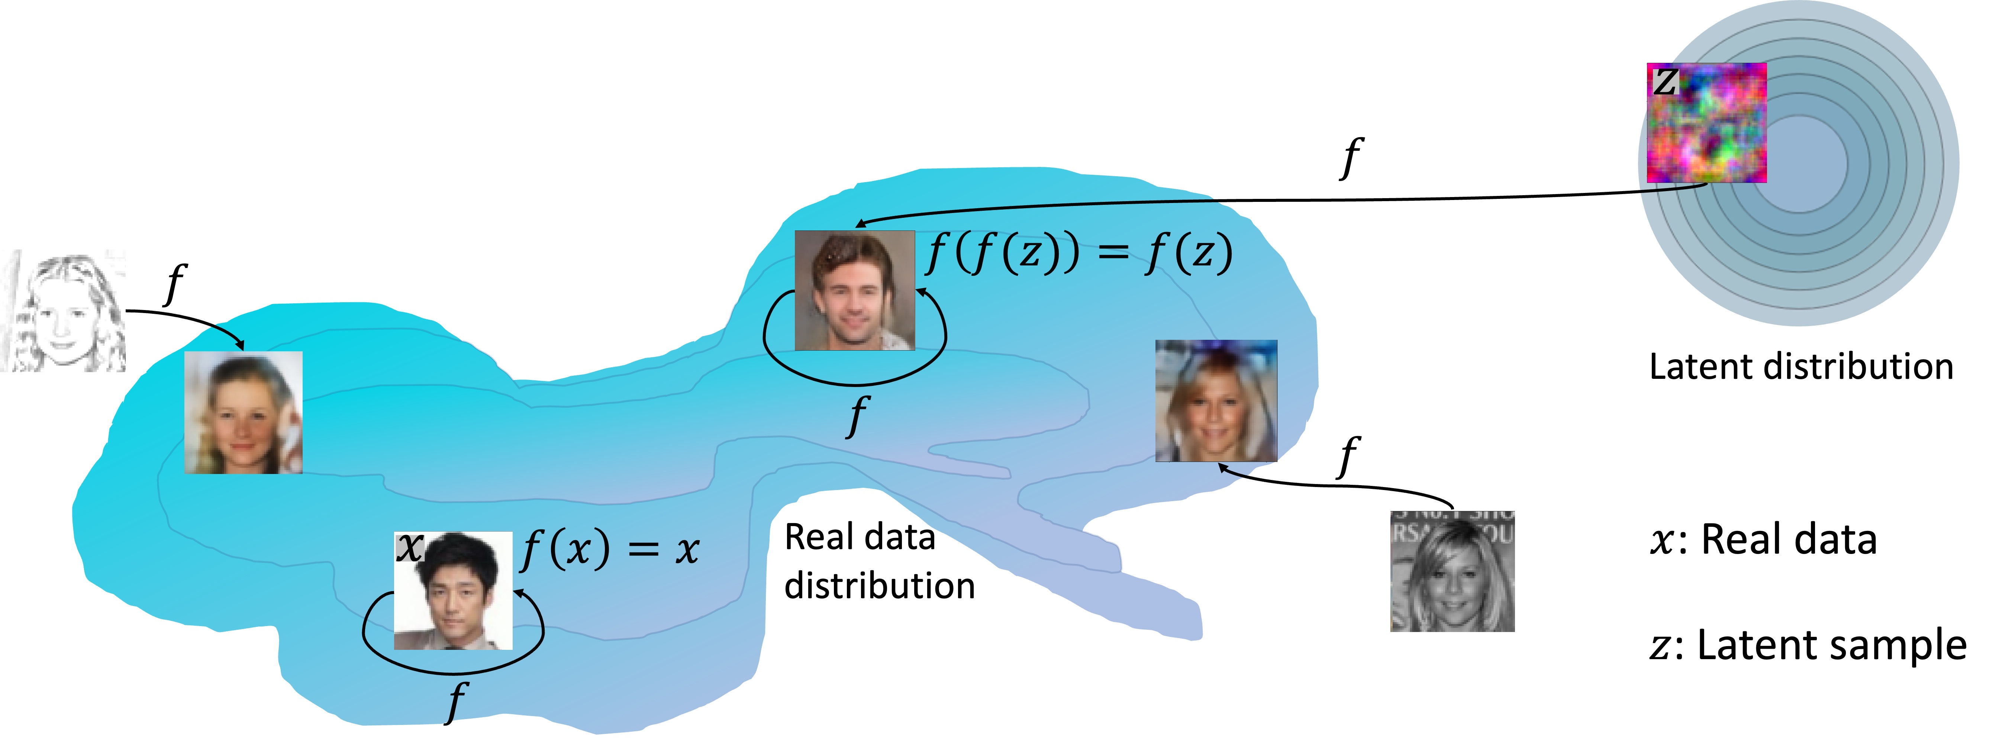
Introduction
(Definition) A matrix M is said to be idempotent if
It is also called a projection matrix.
You can’t overdry

Slide 4
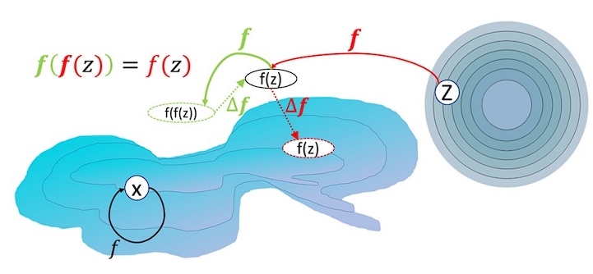
Method
Assume both distribution p_x and p_z lie in the same space.
Three objectives:
Reconstruction objective: f(x) = x
Idempotent objective: f(f(z)) = f(z)
Observation: if f(y) = y for all y, it satisfies the two objective!
Furthermore, the idempotent objective is encouraging the manifold to expand

Slide 5
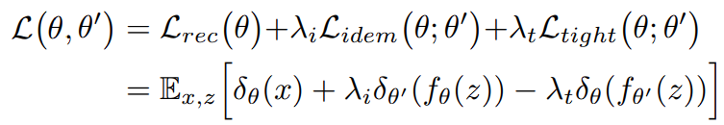
Method
In order to discourage the incentive to expand the manifold, we only optimize w.r.t. the first (inner) instantiation, that, is
Tightness objective:
Final objective:

Slide 6
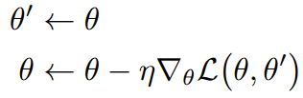
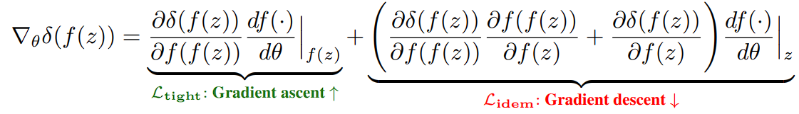
Training
Update rule:
Gradients:

Slide 7
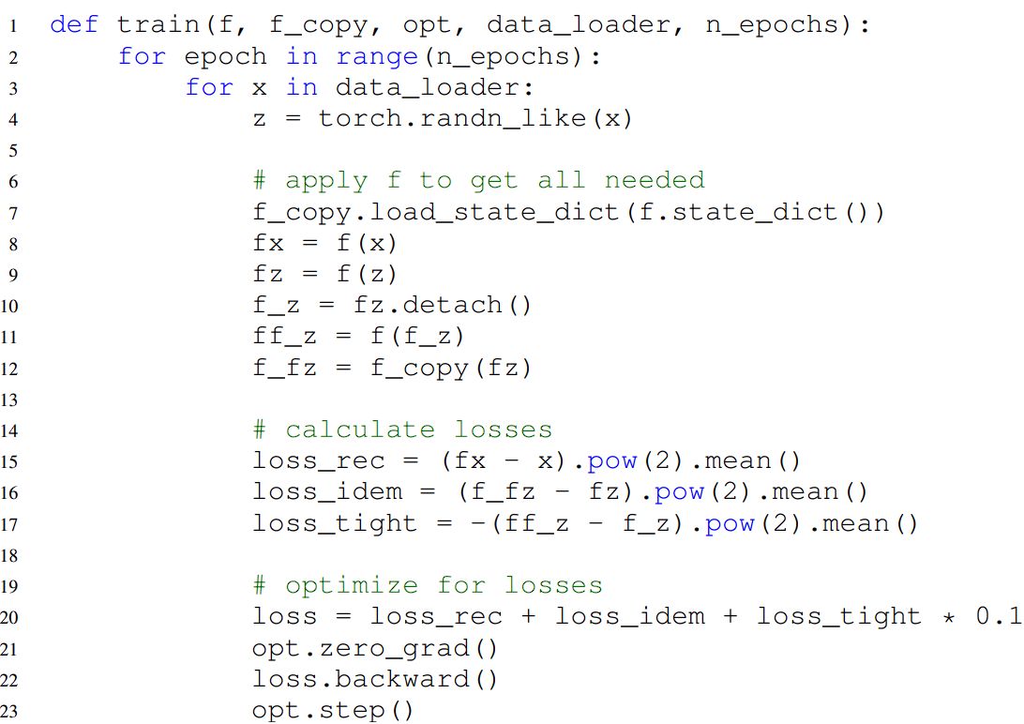
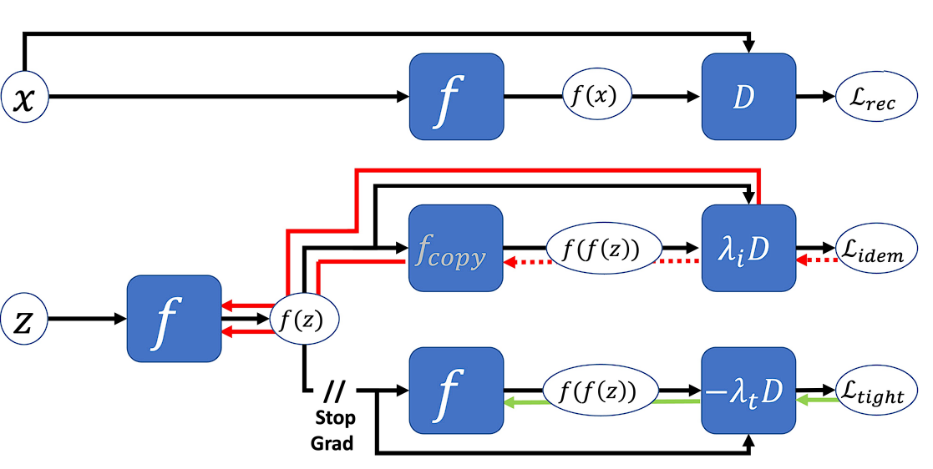
Training

Slide 8
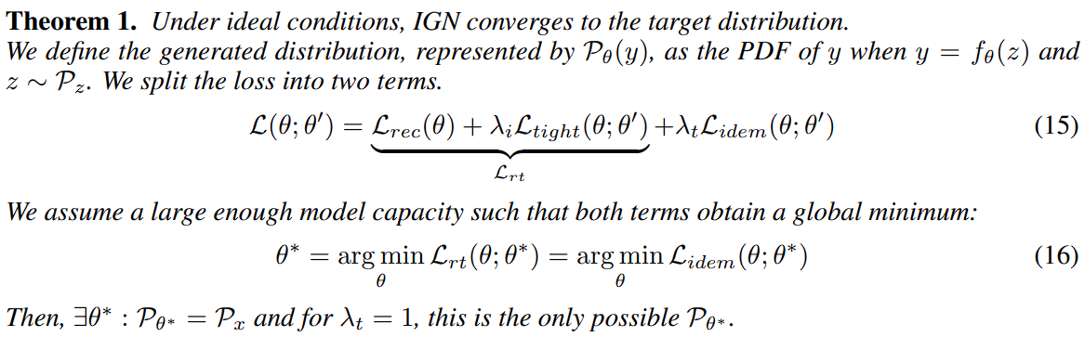
Theory

Slide 9
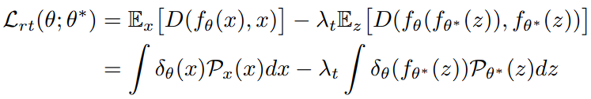
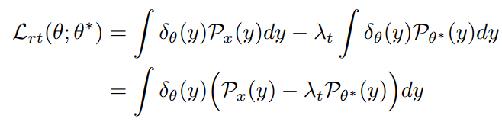
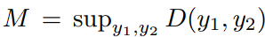
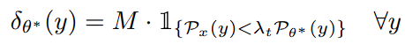
Theory
(Step 1) Observe that
By change of variable
Let . The solution is

Slide 10
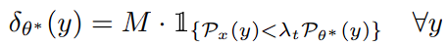
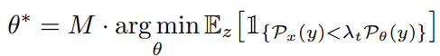
Theory
(Step 2) Observe that
We had already seen . Therefore,
By definition of the optimal theta,
(1) If and , the expectation will be zero
(2) If , the expectation will be positive unless

Slide 11
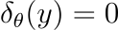
Remark of Theory
The expectation was zero iff iff the definition of being on the estimated manifold.
That is, the expectation measures the probability of a random z to be mapped outside of the manifold.
Optimizing idempotence is essentially maximizing the portion of z’s that are mapped onto the manifold.
In practice, was chosen to be <1

Slide 12
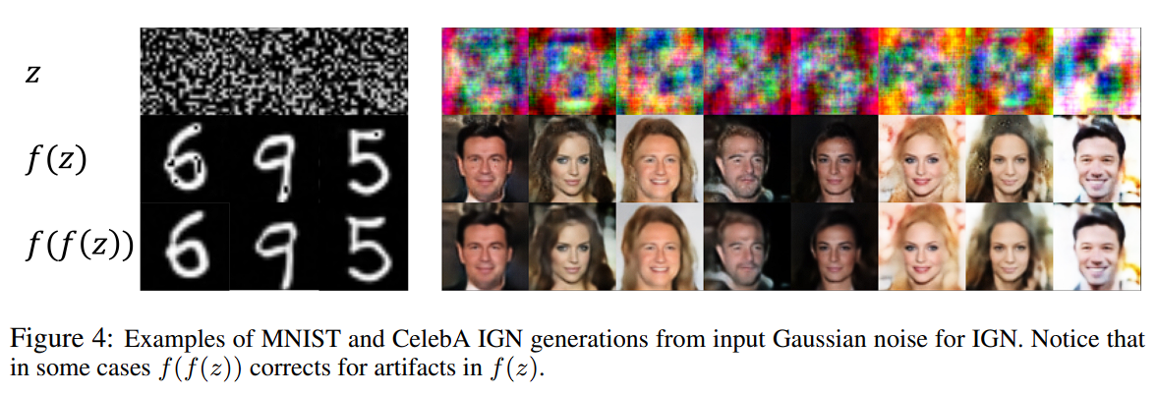
Experimental results

Slide 13
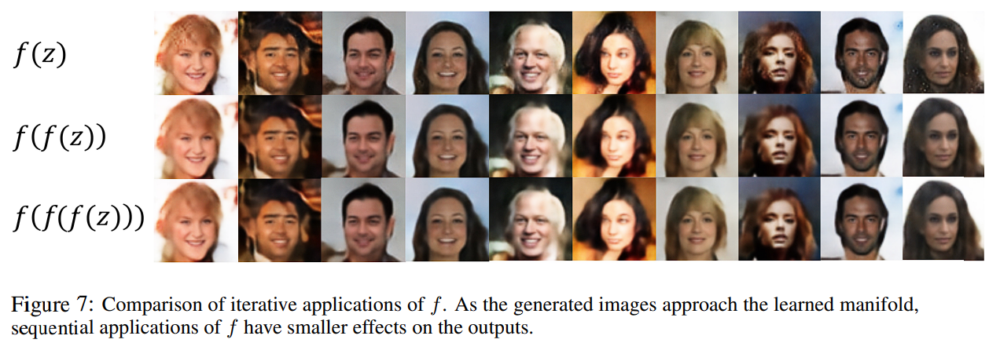
Experimental results

Slide 14
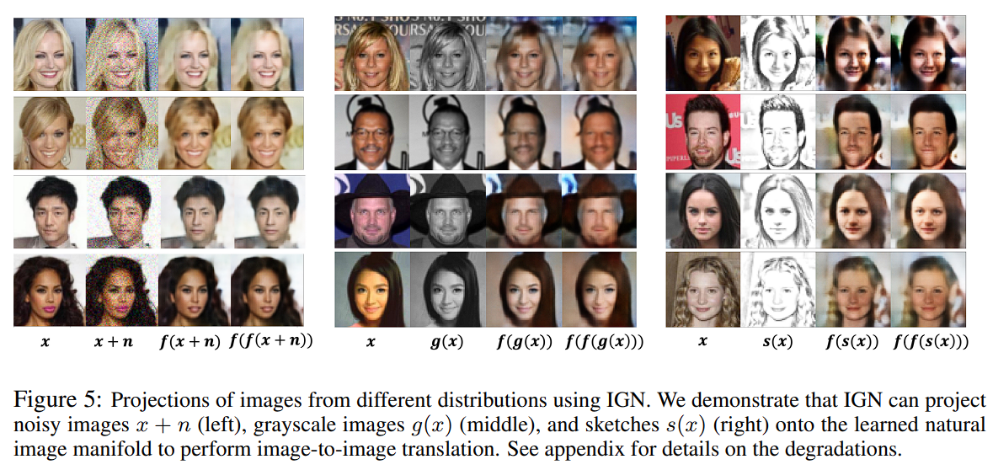
Experimental results

Slide 15
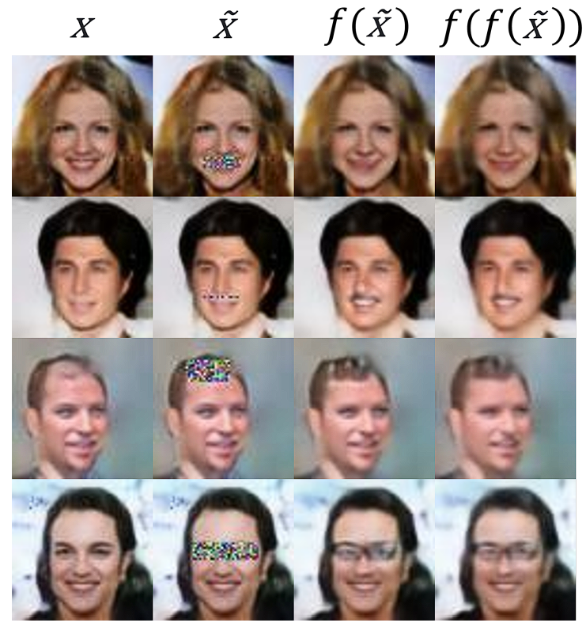
Experimental results

Slide 16
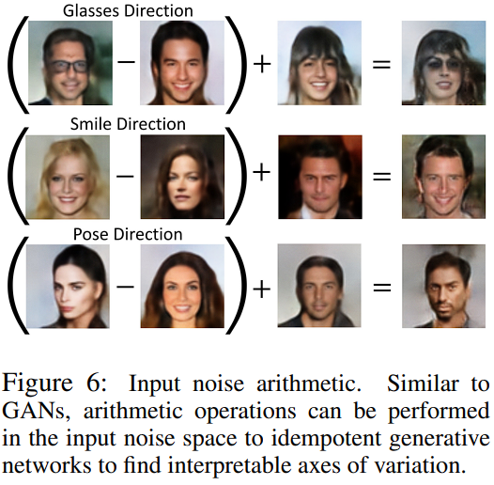
Experimental results

Slide 17
Limitations
Mode collapse (similar to GAN)
Blurriness (similar to VAE)

Slide 18
Reviewer Sz9m (rating: 8)

Slide 19
Reviewer Cz9y (rating: 3)
What if the state space is unbounded? Should we expect states to be restricted to an image hypercube?
Since this method departs heavily from the established probabilistic principles used to justify generative models, clearly demonstrating the validity of the method is essential.

Slide 20
Reviewer 5afM (rating: 5)
Why do we need such a model? What are the potential advantages?
I don't quite get the point of the tightness loss. Why maximize it is good for regularization? More explanation is needed.

Slide 21
Reviewer j2FZ (rating: 8)
Comparison to image denoising with a diffusion model
What about infinite compositions of the mapping?
What are the current drawbacks to scaling this method up?

Slide 22
Reviewer Michael Maire (Public)
Contrary to this paper's claim of introducing a new approach to generative modeling, the proposed Idempotent Generative Network (IGN) is a special case of an Energy-Based Generative Adversarial Network (EBGAN) [Zhao, Mathieu, LeCun; ICLR 2017].

